Slide 1

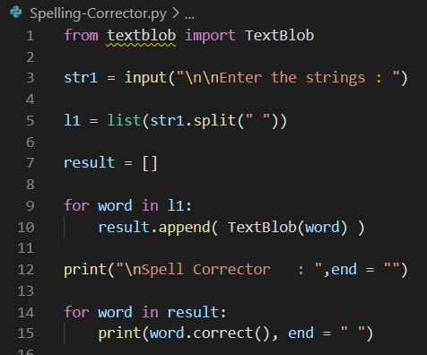

Spell Corrector
Python snippet:
Install textblob in python <pip install textblob>
Output:

